Slide 1
Department of Applied Mathematics and Computational Sciences
III Sem M.Sc.Software Systems
Transform Techniques
Dr. V. Suresh kumar

Slide 2
Transform of special functions

Slide 3
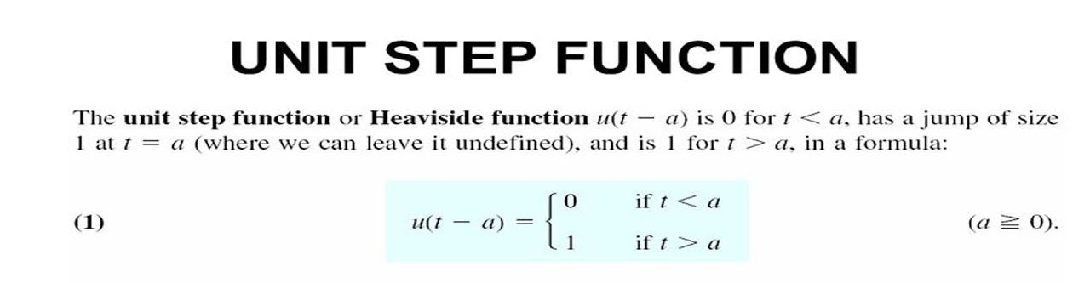
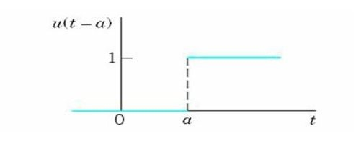
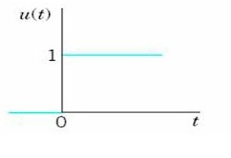
Example
Switch on the light in a dark room

Slide 4
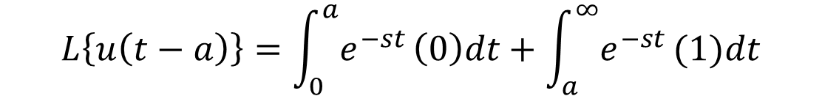
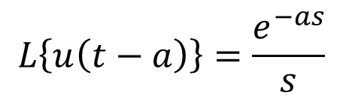
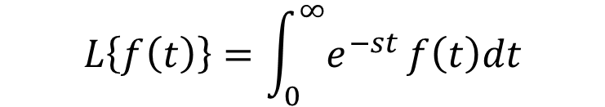
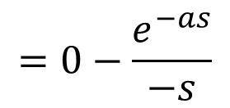
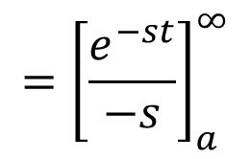
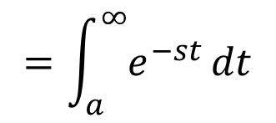
Transform of unit step function
We have
$$L\left\{f\left(t\right)\right\}=\int_{0}^{∞}{e^{−st}}f\left(t\right)dt$$
$$L\left\{u\left(t−a\right)\right\}=\int_{0}^{a}{e^{−st}}\left(0\right)dt+\int_{a}^{∞}{e^{−st}}(1)dt$$
$$=\int_{a}^{∞}{e^{−st}}dt$$
$${=\left[\frac{e^{−st}}{−s}\right]}_{a}^{∞}$$
$$L\left\{u\left(t−a\right)\right\}=\frac{e^{−as}}{s}$$
$$=0−\frac{e^{−as}}{−s}$$

Slide 5
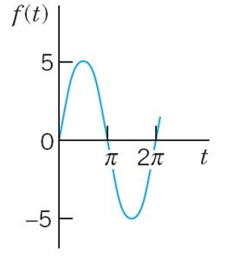
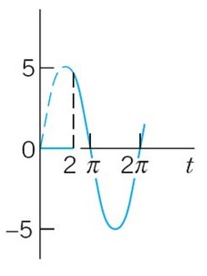
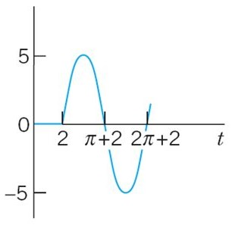



Effect of unit step function
$$f\left(t\right)=5\sin{t}$$
$$f\left(t\right)u(t−2)$$
$$f\left(t−2\right)u(t−2)$$

Slide 6








Problems
1. Represent the following function in terms of unit step function
$$f(t)$$
10
Ans:
6
4
$$f\left(t\right)=4$$
$$− 4$$
$$u(t−8)$$
$$+ 6$$
$$u(t−8)$$
$$f\left(t\right)=4+2u(t−8)$$
8
$$t$$

Slide 7





Problems cont…
2. Express the following function in terms of unit step function
Ans:
$$f\left(t\right)=t$$
$$− t u(t−2)$$
$$+ t^{2} u(t−2)$$
$$− t^{2}u(t−6)$$
$$+ t^{3}u(t−6)$$
$$f\left(t\right)=t+\left[t^{2}−t\right]u\left(t−2\right)+[t^{3}−t^{2}]u(t−6)$$

Slide 8
Homework Problems
Express the following functions in terms of unit step function

Slide 10
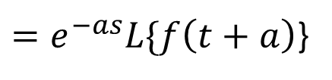
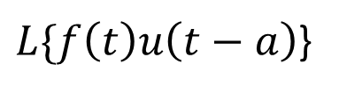

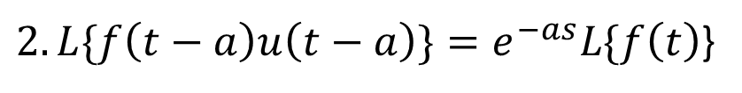

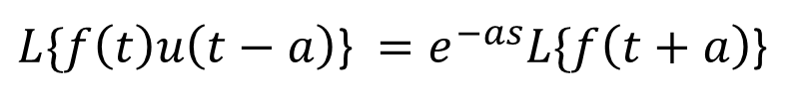

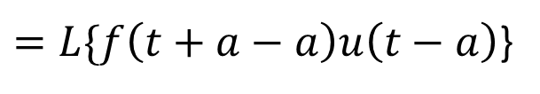
Note
$$1. L\{f\left(t−a\right)u\left(t−a\right)\}=e^{−as}F(s)$$
$2. L\{f\left(t−a\right)u\left(t−a\right)\}=e^{−as}L\{f\left(t\right)$}
$L\{f\left(t\right)u\left(t−a\right)$}
$=L\{f\left(t+a−a\right)u\left(t−a\right)$}
$=e^{−as}L\{f\left(t+a\right)$}
$L\{f\left(t\right)u\left(t−a\right)\text{\}} =e^{−as}L\{f\left(t+a\right)$}
$$3. L^{−1}\left[e^{−as}F(s) \right]=f\left(t−a\right)u\left(t−a\right)$$
$$L^{−1}\left[e^{−as}F(s) \right]=u\left(t−a\right){\left\{L^{−1}\left[F(s)\right]\right\}}_{t→(t−a)}$$
$$=u\left(t−a\right)f(t−a)$$
$$=u\left(t−a\right){\left\{L^{−1}\left[F(s)\right]\right\}}_{t→(t−a)}$$

Slide 11
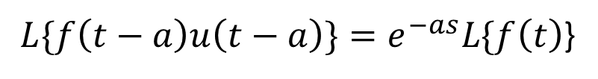
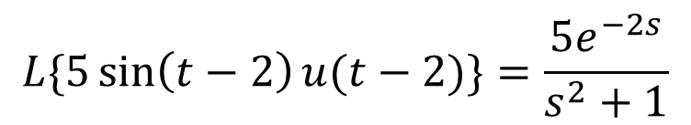
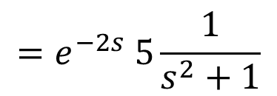
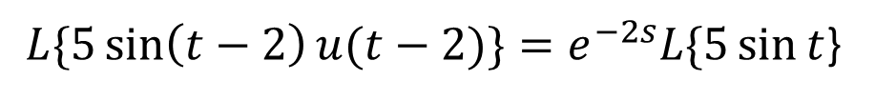
Example Problems
1. Find the Laplace Transform of $5\sin\left(t−2\right)u(t−2)$
Ans:
$L\{f\left(t−a\right)u\left(t−a\right)\}=e^{−as}L\{f\left(t\right)$}
$L\{5\sin\left(t−2\right)u(t−2)\}=e^{−2s}L\{5\sin{t}$}
$$=e^{−2s} 5\frac{1}{s^{2}+1}$$
$$L\{5\sin\left(t−2\right)u(t−2)\}=\frac{5e^{−2s}}{s^{2}+1}$$

Slide 12



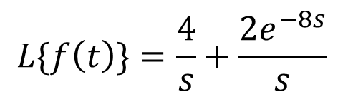

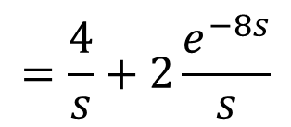




Problems cont…
2. Find the Laplace Transform of
Ans:
$$f\left(t\right)=4$$
$$− 4$$
$$u(t−8)$$
$$+ 6$$
$$u(t−8)$$
$$f\left(t\right)=4+2u(t−8)$$
$$L\{f\left(t\right)\}=L\{4+2u\left(t−8\right)\}$$
$$=L\{4\}+2L\{u\left(t−8\right)\}$$
$$=\frac{4}{s}+2\frac{e^{−8s}}{s}$$
$$L\{f\left(t\right)\}=\frac{4}{s}+\frac{2e^{−8s}}{s}$$

Slide 13
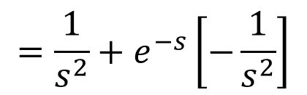

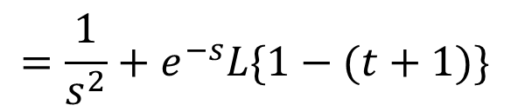
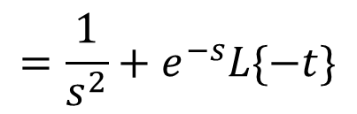


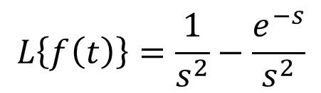
Problems cont…
3. Find the Laplace Transform of
Ans:
$$f\left(t\right)=t−t u\left(t−1\right)+u(t−1)$$
$$f\left(t\right)=t+(1−t) u\left(t−1\right)$$
$$L\{f\left(t\right)\}=L\{t\}+L\{\left(1−t\right)u\left(t−1\right)\}$$
$$=\frac{1}{s^{2}}+e^{−s}L\{1−(t+1)\}$$
$$L\left\{f\left(t\right)\right\}=\frac{1}{s^{2}}−\frac{e^{−s}}{s^{2}}$$
$$=\frac{1}{s^{2}}+e^{−s}L\{−t\}$$
$$=\frac{1}{s^{2}}+e^{−s}\left[−\frac{1}{s^{2}}\right]$$

Slide 14
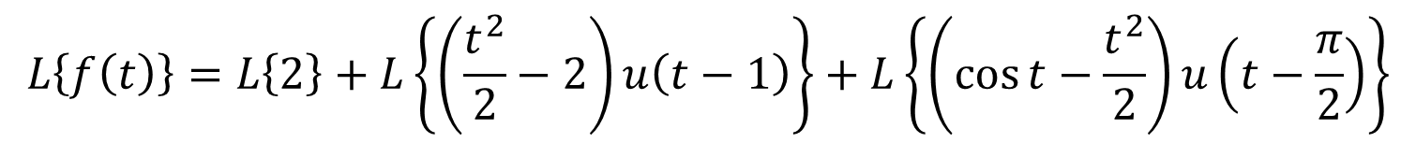
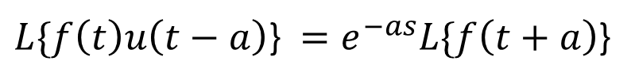
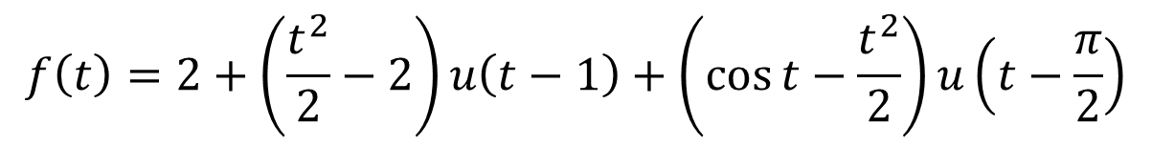
Problems cont…
4. Find the Laplace Transform of
Ans:
$$f\left(t\right)=2−2u\left(t−1\right)+\frac{t^{2}}{2}u\left(t−1\right)−\frac{t^{2}}{2}u\left(t−\frac{π}{2}\right)+\cos{t} u\left(t−\frac{π}{2}\right)$$
$$f\left(t\right)=2+\left(\frac{t^{2}}{2}−2\right)u\left(t−1\right)+\left(\cos{t}−\frac{t^{2}}{2}\right)u\left(t−\frac{π}{2}\right)$$
$$L\left\{f\left(t\right)\right\}=L\left\{2\right\}+L\left\{\left(\frac{t^{2}}{2}−2\right)u\left(t−1\right)\right\}+L\left\{\left(\cos{t}−\frac{t^{2}}{2}\right)u\left(t−\frac{π}{2}\right)\right\}$$
(1)
$L\{f\left(t\right)u\left(t−a\right)\text{\}} =e^{−as}L\{f\left(t+a\right)$}

Slide 15
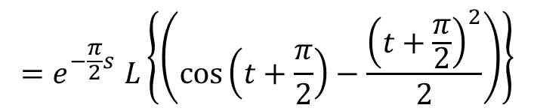
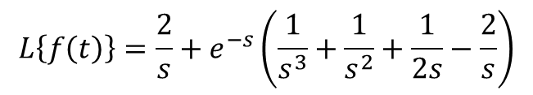
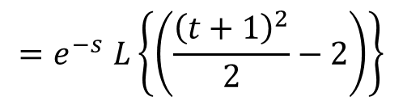
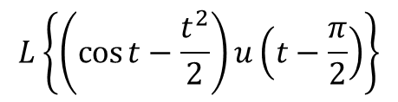
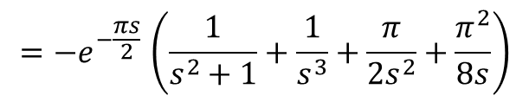
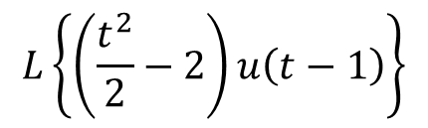
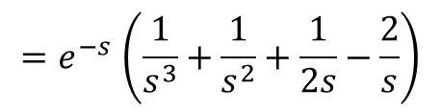
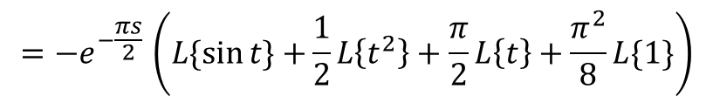
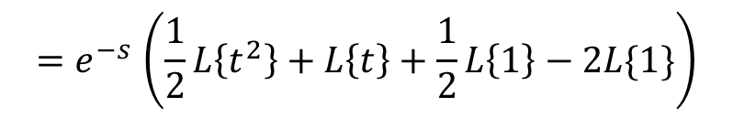
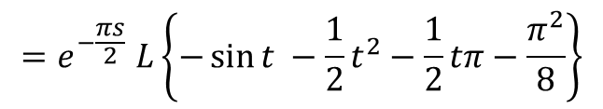
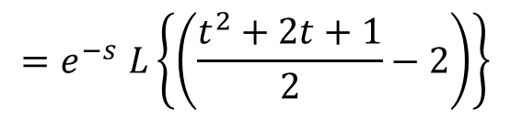
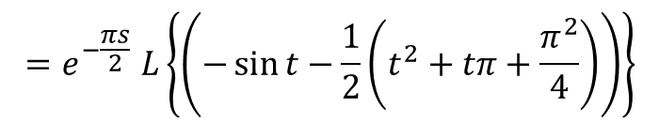
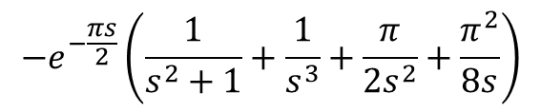
No. 4 cont…
$${=e}^{−\frac{πs}{2}}L\left\{−\sin{t −\frac{1}{2}t^{2}−\frac{1}{2}tπ−\frac{π^{2}}{8}}\right\}$$
To find
$${=−e}^{−\frac{πs}{2}}\left(L\{\sin{t\}+}\frac{1}{2}L\left\{t^{2}\right\}+\frac{π}{2}L\left\{t\right\}+\frac{π^{2}}{8}L\{1\}\right)$$
$$L\left\{\left(\frac{t^{2}}{2}−2\right)u\left(t−1\right)\right\}$$
$${=e}^{−s}L\left\{\left(\frac{{\left(t+1\right)}^{2}}{2}−2\right)\right\}$$
$${=−e}^{−\frac{πs}{2}}\left(\frac{1}{s^{2}+1}+\frac{1}{s^{3}}+\frac{π}{2s^{2}}+\frac{π^{2}}{8s}\right)$$
$${=e}^{−s}L\left\{\left(\frac{t^{2}+2t+1}{2}−2\right)\right\}$$
(3)
$${=e}^{−s}\left(\frac{1}{2}L\left\{t^{2}\right\}+L\left\{t\right\}+\frac{1}{2}L\left\{1\right\}−2L\{1\}\right)$$
Substitute (2) and (3) in (1)
$$L\left\{f\left(t\right)\right\}=\frac{2}{s}+e^{−s}\left(\frac{1}{s^{3}}+\frac{1}{s^{2}}+\frac{1}{2s}−\frac{2}{s}\right)$$
$${=e}^{−s}\left(\frac{1}{s^{3}}+\frac{1}{s^{2}}+\frac{1}{2s}−\frac{2}{s}\right)$$
(2)
$${−e}^{−\frac{πs}{2}}\left(\frac{1}{s^{2}+1}+\frac{1}{s^{3}}+\frac{π}{2s^{2}}+\frac{π^{2}}{8s}\right)$$
To find
$${=e}^{−\frac{π}{2}s}L\left\{\left(\cos\left(t+\frac{π}{2}\right)−\frac{{\left(t+\frac{π}{2}\right)}^{2}}{2}\right)\right\}$$
$$L\left\{\left(\cos{t}−\frac{t^{2}}{2}\right)u\left(t−\frac{π}{2}\right)\right\}$$
$${=e}^{−\frac{πs}{2}}L\left\{\left(−\sin{t}−\frac{1}{2}\left(t^{2}+tπ+\frac{π^{2}}{4}\right)\right)\right\}$$

Slide 16




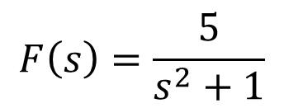

Problems cont…
5. Find the Inverse Laplace Transform of $\frac{5e^{−2s}}{s^{2}+1}$
Ans:
We have
$$L^{−1}\left[e^{−as}F(s) \right]=u\left(t−a\right){\left\{L^{−1}\left[F(s)\right]\right\}}_{t→(t−a)}$$
Take
$$F\left(s\right)=\frac{5}{s^{2}+1}$$
$$L^{−1}\left[e^{−2s}F(s) \right]$$
$$=u\left(t−2\right){\left\{L^{−1}\left[F(s)\right]\right\}}_{t→(t−2)}$$
$$=u\left(t−2\right){\left\{5\sin{t}\right\}}_{t→(t−2)}$$
$$L^{−1}\left[e^{−2s}F(s) \right]$$
$$=5u\left(t−2\right)\sin{(t−2)}$$

Slide 17
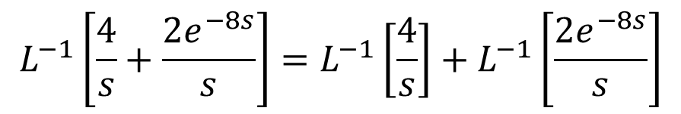

Problems cont…
6. Find the Inverse Laplace Transform of $\frac{4}{s}+\frac{2e^{−8s}}{s}$
Ans:
$$L^{−1}\left[\frac{4}{s}+\frac{2e^{−8s}}{s}\right]=L^{−1}\left[\frac{4}{s}\right]+L^{−1}\left[\frac{2e^{−8s}}{s}\right]$$
$$=4+2u(t−8)$$

Slide 18
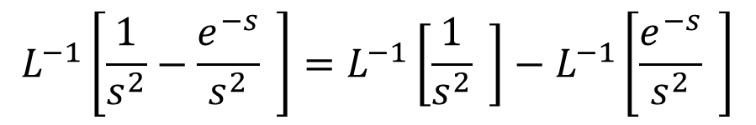


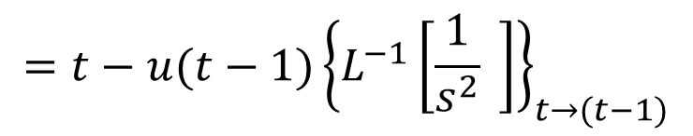
Problems cont…
7. Find the Inverse Laplace Transform of $\frac{1}{s^{2}}−\frac{e^{−s}}{s^{2}}$
Ans:
$$L^{−1}\left[\frac{1}{s^{2}}−\frac{e^{−s}}{s^{2}} \right]=L^{−1}\left[\frac{1}{s^{2}} \right]−L^{−1}\left[\frac{e^{−s}}{s^{2}} \right]$$
$$=t−u(t−1){\left\{L^{−1}\left[\frac{1}{s^{2}} \right]\right\}}_{t→(t−1)}$$
$$=t−u(t−1){\left\{t\right\}}_{t→(t−1)}$$
$$=t−(t−1)u(t−1)$$

Slide 19
Homework problems
Find the Laplace Transform for the following

Slide 20

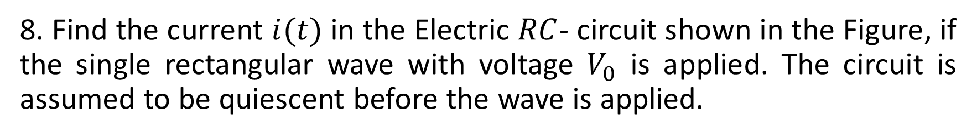
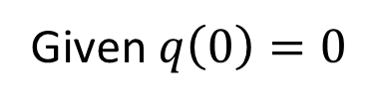
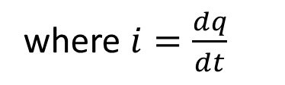

Problems cont…
8. Find the current $i(t)$ in the Electric $RC$- circuit shown in the Figure, if the single rectangular wave with voltage $V_{0}$ is applied. The circuit is assumed to be quiescent before the wave is applied.
Ans:
$$Ri+\frac{q}{C}=v(t)$$
where $i=\frac{dq}{dt}$
Given $q\left(0\right)=0$
$$v\left(t\right)=V_{0}u\left(t−a\right)−V_{0}u(t−b)$$

Slide 21





Problem No. 8 cont…
$$Ri+\frac{q}{C}=v(t)$$
$$R\frac{dq}{dt}+\frac{q}{C}=V_{0}u\left(t−a\right)−V_{0}u(t−b)$$
$$R q′(t)+\frac{q(t)}{C}=V_{0}[u\left(t−a\right)−u\left(t−b\right)]$$
Taking Laplace Transform on both sides
$$L \left\{R q′(t)+\frac{q\left(t\right)}{C}\right\}=V_{0} L\left\{[u\left(t−a\right)−u\left(t−b\right)]\right\}$$
$$RL \left\{ q′(t) \right\}+\frac{1}{C}L \left\{ q(t)\right\}=V_{0} \left\{L[u\left(t−a\right)]−L[u\left(t−b\right)]\right\}$$
$$RsL \left\{ q(t) \right\}−Rq(0)+\frac{1}{C}L \left\{ q(t)\right\}=V_{0} \left\{\frac{e^{−as}}{s}−\frac{e^{−bs}}{s}\right\}$$

Slide 22














Problem No. 8 cont…
Consider
$$\left(Rs+\frac{1}{C}\right)L \left\{ q(t)\right\}=V_{0} \left\{\frac{e^{−as}}{s}−\frac{e^{−bs}}{s}\right\}$$
$$\frac{1}{s\left(s+\frac{1}{RC}\right)}=\frac{A}{s}+\frac{B}{\left(s+\frac{1}{RC}\right)}$$
$$1=A\left(s+\frac{1}{RC}\right)+Bs$$
$$\left(\frac{RCs+1}{C}\right)L \left\{ q(t)\right\}=V_{0} \left\{\frac{e^{−as}}{s}−\frac{e^{−bs}}{s}\right\}$$
Put $s=0$
Put $s=\frac{−1}{RC}$
$$1=A\left(\frac{1}{RC}\right)$$
$$L \left\{ q(t)\right\}=V_{0}\left(\frac{C}{RCs+1}\right)\left\{\frac{e^{−as}}{s}−\frac{e^{−bs}}{s}\right\}$$
$$1=B\left(\frac{−1}{RC}\right)$$
$$A=RC$$
B$=−RC$
$$L \left\{ q(t)\right\}=V_{0}\frac{1}{RC}\left(\frac{C}{s+\frac{1}{RC}}\right)\left\{\frac{e^{−as}}{s}−\frac{e^{−bs}}{s}\right\}$$
$$\frac{1}{s\left(s+\frac{1}{RC}\right)}=\frac{RC}{s}−\frac{RC}{\left(s+\frac{1}{RC}\right)}$$
(2)
$$L \left\{ q(t)\right\}=\left(\frac{V_{0}}{R}\right)\left\{\frac{e^{−as}}{s\left(s+\frac{1}{RC}\right)}−\frac{e^{−bs}}{s\left(s+\frac{1}{RC}\right)}\right\}$$
Substitute (2) in (1)
(1)

Slide 23



Problem No. 8 cont…
$$L \left\{ q(t)\right\}=\left(\frac{V_{0}}{R}\right)\left\{e^{−as}\left(\frac{RC}{s}−\frac{RC}{\left(s+\frac{1}{RC}\right)}\right)−e^{−bs}\left(\frac{RC}{s}−\frac{RC}{\left(s+\frac{1}{RC}\right)}\right)\right\}$$
$$L \left\{ q(t)\right\}=\left(\frac{V_{0}RC}{R}\right)\left\{\frac{e^{−as}}{s}−\frac{e^{−as}}{\left(s+\frac{1}{RC}\right)}−\frac{e^{−bs}}{s}+\frac{e^{−bs}}{\left(s+\frac{1}{RC}\right)}\right\}$$
$$q(t)=\left(V_{0}C\right)\left\{L^{−1}\left[\frac{e^{−as}}{s}−\frac{e^{−as}}{\left(s+\frac{1}{RC}\right)}−\frac{e^{−bs}}{s}+\frac{e^{−bs}}{\left(s+\frac{1}{RC}\right)}\right]\right\}$$
$$q(t)=\left(V_{0}C\right)\left\{u\left(t−a\right)−u\left(t−a\right){\left\{\left[\frac{1}{\left(s+\frac{1}{RC}\right)}\right]\right\}}_{t→\left(t−a\right)}−u\left(t−b\right)+u\left(t−b\right){\left\{\left[\frac{1}{\left(s+\frac{1}{RC}\right)}\right]\right\}}_{t→\left(t−b\right)}\right\}$$
$$q(t)=\left(V_{0}C\right)\left\{u\left(t−a\right)−u\left(t−a\right){\left\{e^{\frac{−1}{RC}t}\right\}}_{t→\left(t−a\right)}−u\left(t−b\right)+u\left(t−b\right){\left\{e^{\frac{−1}{RC}t}\right\}}_{t→\left(t−b\right)}\right\}$$
$$q(t)=\left(V_{0}C\right)\left\{u\left(t−a\right)−u\left(t−a\right)e^{\frac{−1}{RC}(t−a)}−u\left(t−b\right)+u\left(t−b\right)e^{\frac{−1}{RC}(t−b)}\right\}$$

Slide 24





Problem No. 8 cont…
Differentiate both sides w.r.t t
$$i\left(t\right)=\frac{dq}{dt}=\left(V_{0}C\right)\left\{0−u\left(t−a\right)e^{\frac{−1}{RC}\left(t−a\right)}\left(\frac{−1}{RC}\right)−0+u\left(t−b\right)e^{\frac{−1}{RC}(t−b)}\left(\frac{−1}{RC}\right)\right\}$$
$$i\left(t\right)=\left(V_{0}C\right)\left(\frac{1}{RC}\right)\left\{u\left(t−a\right)e^{\frac{−1}{RC}\left(t−a\right)}−u\left(t−b\right)e^{\frac{−1}{RC}(t−b)}\right\}$$
$$i\left(t\right)=\left(\frac{V_{0}}{R}\right)\left\{e^{\frac{−1}{RC}\left(t−a\right)}u\left(t−a\right)−e^{\frac{−1}{RC}(t−b)}u\left(t−b\right)\right\}$$
Aliter
$$Ri(t)+\frac{q(t)}{C}=v(t)$$
where $i=\frac{dq}{dt}$
$$Ri(t)+\frac{1}{C}\int_{0}^{t}{i\left(t\right)dt}=V_{0}u\left(t−a\right)−V_{0}u(t−b)$$
Taking Laplace Transform on both sides

Slide 25











Problem No. 8 cont…
$$L\left\{Ri(t)+\frac{1}{C}\int_{0}^{t}{i\left(t\right)dt}\right\}=L\{V_{0}u\left(t−a\right)−V_{0}u\left(t−b\right)\}$$
$$L\left\{\int_{0}^{t}{f\left(t\right)dt}\right\}=\frac{F(s)}{s}$$
$$RL\left\{i(t)\right\}+\frac{1}{C}L\left\{\int_{0}^{t}{i\left(t\right)dt}\right\}=V_{0}L\{u\left(t−a\right)\}−V_{0}L\{u\left(t−b\right)\}$$
$$RL\left\{i(t)\right\}+\frac{1}{C}\frac{L\left\{i(t)\right\}}{s}=V_{0}\frac{e^{−as}}{s}−V_{0}\frac{e^{−bs}}{s}$$
$$L \left\{ i(t)\right\}=V_{0}\frac{1}{RC}\left(\frac{C}{s+\frac{1}{RC}}\right)\left\{e^{−as}−e^{−bs}\right\}$$
$$L \left\{ i(t)\right\}=\left(\frac{V_{0}}{R}\right)\left\{e^{−as}\left(\frac{1}{\left(s+\frac{1}{RC}\right)}\right)−e^{−bs}\left(\frac{1}{\left(s+\frac{1}{RC}\right)}\right)\right\}$$
$$\left(R+\frac{1}{Cs}\right)L\left\{i(t)\right\}=V_{0}\left[\frac{e^{−as}}{s}−\frac{e^{−bs}}{s}\right]$$
$$i(t)=\left(\frac{V_{0}}{R}\right)\left\{L^{−1}\left[\frac{e^{−as}}{\left(s+\frac{1}{RC}\right)}−\frac{e^{−bs}}{\left(s+\frac{1}{RC}\right)}\right]\right\}$$
$$L \left\{ i(t)\right\}=V_{0}\left(\frac{Cs}{RCs+1}\right)\left\{\frac{e^{−as}}{s}−\frac{e^{−bs}}{s}\right\}$$
$$L \left\{ i(t)\right\}=V_{0}\left(\frac{C}{RCs+1}\right)\left\{e^{−as}−e^{−bs}\right\}$$
$$i\left(t\right)=\left(\frac{V_{0}}{R}\right)\left\{e^{\frac{−1}{RC}\left(t−a\right)}u\left(t−a\right)−e^{\frac{−1}{RC}(t−b)}u\left(t−b\right)\right\}$$

Slide 26









Unit Impulse (Dirac delta) Function
Consider the auxiliary function $g\left(t−a\right)=\left\{\begin{aligned}\frac{1}{h}, a<t<a+h \\ 0, otherwise \end{aligned}\right.$
$$δ\left(t−a\right)$$
$$g\left(t−a\right)$$
$$δ\left(t−a\right)=\lim_{h→0}{g\left(t−a\right)}$$
$$\frac{1}{h}$$
$$0$$
$$a$$
$$a+h$$
$$t$$

Slide 27














Transform of the function
$$L\left\{g\left(t−a\right)\right\}=\frac{1}{h}\left[\frac{e^{−as}}{s}−\frac{e^{−as−hs}}{s}\right]$$
We have
$$=\frac{1}{h}\left[\frac{e^{−as}}{s}\left(1−e^{−hs}\right)\right]$$
$$L\left\{f\left(t\right)\right\}=\int_{0}^{∞}{e^{−st}}f\left(t\right)dt$$
$$δ\left(t−a\right)=\lim_{h→0}{g\left(t−a\right)}$$
$$L\left\{g\left(t−a\right)\right\}=\int_{a}^{a+h}{e^{−st}}\left(\frac{1}{h}\right)dt$$
$$L\{δ\left(t−a\right)\}=\lim_{h→0}{L\{g\left(t−a\right)\}}$$
$$=\frac{1}{h}\int_{a}^{a+h}{e^{−st}}dt$$
$$=\lim_{h→0}\frac{1}{h}\left[\frac{e^{−as}}{s}\left(1−e^{−hs}\right)\right]$$
$${=\frac{1}{h}\left[\frac{e^{−st}}{−s}\right]}_{a}^{a+h}$$
$$=\frac{e^{−as}}{s}\lim_{h→0}\left(\frac{1−e^{−hs}}{h}\right)$$
$$=\frac{1}{h}\left[\frac{e^{−s(a+h)}}{−s}−\frac{e^{−as}}{−s}\right]$$
$$=\frac{e^{−as}}{s}\lim_{h→0}\left(se^{−hs}\right)$$
$$=\frac{e^{−as}}{s}(s)$$
Real time scenario: Hitting a ball in the bat
$$L\{δ\left(t−a\right)\}=e^{−as}$$

Slide 28




Problems
9. Determine the response of the damped mass-spring system under a square wave, modeled by $y^{′′}+3y^{′}+2y=r(t), y\left(0\right)=0, y^{′}\left(0\right)=0$ where $r\left(t\right)=u\left(t−1\right)−u\left(t−2\right).$
Sol:
Given
$$y^{′′}+3y^{′}+2y=r(t)$$
Taking Laplace Transform on both sides
$${L\{y}^{′′}\}+3{L\{y}^{′}\}+2L\{y\}=L\{r\left(t\right)\}$$
$$s^{2}L\left\{y\left(t\right)\right\}−sy\left(0\right)−y^{′}\left(0\right)+3\left[sL\left\{y\right\}−y\left(0\right)\right]+2L\{y\}=L\{u\left(t−1\right)−u\left(t−2\right)\}$$
$$s^{2}L\left\{y\left(t\right)\right\}+3sL\left\{y\right\} +2L\{y\}=L\{u\left(t−1\right)\}−L\{u\left(t−2\right)\}$$
$$\left(s^{2}+3s +2\right)L\{y\}=\frac{e^{−s}}{s}−\frac{e^{−2s}}{s}$$
$$L\{y\}=\frac{e^{−s}}{s\left(s^{2}+3s +2\right)}−\frac{e^{−2s}}{s\left(s^{2}+3s +2\right)}$$

Slide 29












Problem No. 9 cont…
$$L\{y\}=\frac{e^{−s}}{s\left(s+1\right)(s+2)}−\frac{e^{−2s}}{s\left(s+1\right)(s+2)}$$
(1)
Consider
$$\frac{1}{s\left(s+1\right)(s+2)}=\frac{A}{s}+\frac{B}{s+1}+\frac{C}{s+2}$$
$$1=A\left(s+1\right)\left(s+2\right)+Bs\left(s+2\right)+Cs(s+1)$$
Put $s=0$
Put $s=−1$
Put $s=−2$
$$1=A\left(1\right)\left(2\right)$$
$$1=B\left(−1\right)\left(1\right)$$
$$1=C\left(−2\right)\left(−1\right)$$
$$A=\frac{1}{2}$$
$$B=−1$$
$$C=\frac{1}{2}$$
$$\frac{1}{s\left(s+1\right)(s+2)}=\frac{\frac{1}{2}}{s}−\frac{1}{s+1}+\frac{\frac{1}{2}}{s+2}$$

Slide 30



Problem No. 9 cont…
(1) becomes
$$L\{y\}=e^{−s}\left(\frac{\frac{1}{2}}{s}−\frac{1}{s+1}+\frac{\frac{1}{2}}{s+2}\right)−e^{−2s}\left(\frac{\frac{1}{2}}{s}−\frac{1}{s+1}+\frac{\frac{1}{2}}{s+2}\right)$$
$$L\left\{y\right\}=\frac{1}{2}\frac{e^{−s}}{s}−\frac{e^{−s}}{s+1}+\frac{1}{2}\frac{e^{−s}}{s+2}−\frac{1}{2}\frac{e^{−2s}}{s}+\frac{e^{−2s}}{s+1}−\frac{1}{2}\frac{e^{−2s}}{s+2}$$
$$y=L^{−1}\left[\frac{1}{2}\frac{e^{−s}}{s}−\frac{e^{−s}}{s+1}+\frac{1}{2}\frac{e^{−s}}{s+2}−\frac{1}{2}\frac{e^{−2s}}{s}+\frac{e^{−2s}}{s+1}−\frac{1}{2}\frac{e^{−2s}}{s+2}\right]$$
$$y=\frac{1}{2}L^{−1}\left[\frac{e^{−s}}{s}\right]−L^{−1}\left[\frac{e^{−s}}{s+1}\right]+\frac{1}{2}L^{−1}\left[\frac{e^{−s}}{s+2}\right]−\frac{1}{2}L^{−1}\left[\frac{e^{−2s}}{s}\right]+L^{−1}\left[\frac{e^{−2s}}{s+1}\right]−\frac{1}{2}L^{−1}\left[\frac{e^{−2s}}{s+2}\right]$$
$$y=\frac{1}{2}u\left(t−1\right)−u\left(t−1\right){\left\{e^{−t}\right\}}_{t→\left(t−1\right)} +\frac{1}{2}u\left(t−1\right){\left\{e^{−2t}\right\}}_{t→\left(t−1\right)}−\frac{1}{2}u\left(t−2\right)+u\left(t−2\right){\left\{e^{−t}\right\}}_{t→\left(t−2\right)} −\frac{1}{2}u(t−2){\left\{e^{−2t}\right\}}_{t→(t−2)}$$
$$y=\frac{1}{2}u\left(t−1\right)−u\left(t−1\right)e^{−(t−1)}+\frac{1}{2}u\left(t−1\right)e^{−2(t−1)}−\frac{1}{2}u\left(t−2\right)+u\left(t−2\right)e^{−(t−2)}−\frac{1}{2}u(t−2)e^{−2(t−2)}$$

Slide 31






Problems
10. Determine the response of the damped mass-spring system under a unit impulse, modeled by $y^{′′}+3y^{′}+2y=r(t), y\left(0\right)=0, y^{′}\left(0\right)=0$ where $r\left(t\right)=δ\left(t−1\right).$
Sol:
Given
$$y^{′′}+3y^{′}+2y=r(t)$$
Taking Laplace Transform on both sides
$${L\{y}^{′′}\}+3{L\{y}^{′}\}+2L\{y\}=L\{r\left(t\right)\}$$
$$s^{2}L\left\{y\left(t\right)\right\}−sy\left(0\right)−y^{′}\left(0\right)+3\left[sL\left\{y\right\}−y\left(0\right)\right]+2L\{y(t)\}=L\{δ\left(t−1\right)\}$$
$$\left(s^{2}+3s +2\right)L\{y\}=e^{−s}$$
$$L\{y\}=\frac{e^{−s}}{\left(s^{2}+3s +2\right)}$$
$$y=L^{−1}\left[\frac{e^{−s}}{\left(s^{2}+3s +2\right)}\right]$$

Slide 32















Problem cont…
$$y=u\left(t−1\right){\left\{L^{−1}\left[\frac{1}{\left(s^{2}+3s +2\right)}\right]\right\}}_{t→(t−1)}$$
(1)
Consider
$$\frac{1}{\left(s+1\right)(s+2)}=\frac{1}{s+1}−\frac{1}{s+2}$$
$$\frac{1}{\left(s^{2}+3s +2\right)}=\frac{1}{\left(s+1\right)(s+2)}$$
$$L^{−1}\left[\frac{1}{\left(s^{2}+3s +2\right)}\right]=L^{−1}\left[\frac{1}{s+1}−\frac{1}{s+2}\right]$$
$$\frac{1}{\left(s+1\right)(s+2)}=\frac{A}{s+1}+\frac{B}{s+2}$$
$$L^{−1}\left[\frac{1}{\left(s^{2}+3s +2\right)}\right]=e^{−t}−e^{−2t}$$
$$1=A\left(s+2\right)+B\left(s+1\right)$$
(1) becomes
Put $s=−1$
Put $s=−2$
$$y=u\left(t−1\right){\left\{e^{−t}−e^{−2t}\right\}}_{t→(t−1)}$$
$$1=A\left(1\right)$$
$$1=B\left(−1\right)$$
$$y=u\left(t−1\right)\left\{e^{−(t−1)}−e^{−2(t−1)}\right\}$$
$$A=1$$
$$B=−1$$

Slide 33
Homework problems
Solve the following initial value problems
(1)
(2)
(3)
(4)

Slide 34


